Slide 1
Discrete Mathematics BCSC0010
Module 1
Bayes’ Theorem

Slide 2

Partition of a sample space
A set of events E₁, E₂, …, E_{n} is said to represent a partition of the sample space S if
In other words, the events E₁, E₂, …, E_{n} represent a partition of the sample space S if they are pairwise disjoint (mutually exclusive), exhaustive and have nonzero probabilities.

Slide 3
Example
In a throw of 1 die
Sample space, S={1,2,3,4,5,6}
Let E1={1,3,5} and E2={2,4,6}
E1 ⋂ E2=ϕ
E1U E2=S
P(E1),P(E2)>0
Therefore E1 and E2 are the partitions of sample space S

Slide 4
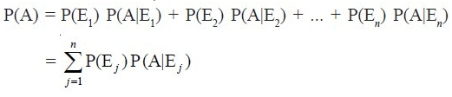
Total Probability
Let {E₁, E₂,…,E_{n}} be a partition of the sample space S, and suppose that each of the events E₁, E₂,…, E_{n} has nonzero probability of occurrence. Let A be any event associated with S, then total probability (P(A)) can be given as,

Slide 5


Example
Let Event A: construction work will completed on time
Event B: there is a strike on construction site
Event B’ : there is a not a strike on construction site
B ⋂ B’ =ϕ , B and B’ is a partition of sample space S
To find: P(A)
Given : P(B)=0.65, P(B’)=1-0.65=0.35, P(A|B’)=0.8, P(A|B)=0.32
By theorem of Total probability,

Slide 6
Bayes' theorem
Bayes' theorem (Bayes's law or Bayes's rule) describes the probability of an event, based on prior knowledge of conditions that might be related to the event.

Slide 7

Bayes' theorem
If E₁, E₂ ,…, E_{n} are n non empty events which constitute a partition of sample space S, i.e. E₁, E₂ ,…, E_{n} are pairwise disjoint and E₁∪ E₂∪ … ∪ E_{n} = S and A is any event of nonzero probability, then
The probability P(E_{i}) is called the prior probability E_{i} The conditional probability P(E_{i} |A) is called a posterior probability of E_{i}.

Slide 8

Example
Bag I contains 3 red and 4 black balls while another Bag II contains 5 red and 6 black balls. One ball is drawn at random from one of the bags and it is found to be red. Find the probability that it was drawn from Bag II.
Solution
Let E₁ be the event of choosing the bag I,
E₂ the event of choosing the bag II
A be the event of drawing a red ball , then

Slide 9


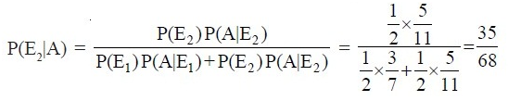
Also
Now, the probability of drawing a ball from Bag II, being given that it is red, is P(E₂|A) By using Bayes’ theorem, we have

Slide 10

Example
Given three identical boxes I, II and III, each containing two coins. In box I, both coins are gold coins, in box II, both are silver coins and in the box III, there is one gold and one silver coin. A person chooses a box at random and takes out a coin. If the coin is of gold, what is the probability that the other coin in the box is also of gold?
Solution
Let E₁, E₂ and E₃ be the events that boxes I, II and III are chosen, respectively. Then

Slide 11
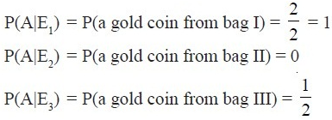

Also, let A be the event that ‘the coin drawn is of gold’ Then
Now, the probability that the other coin in the box is of gold

Slide 12
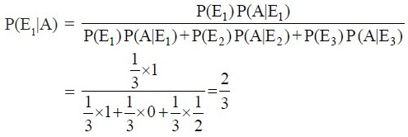
By Bayes’ theorem, we know that

